Slide 1
Records Quick Guides

Slide 2
Basic Record Reviews
Parish Church Records
Civil Registration
Village Family Histories

Slide 3
1. Parish Church Records
Dates: some as early as 1500s
Roman Catholic records vary upon diocese and parish policies
Records therefore vary by parish and era

Slide 4
1. Parish Church Records
Beginning in the 1800s you will find Kirchenbuchduplikate or church book duplicates
Some authorities required annual registers
One site of many sites on Church Records is www.archion.de

Slide 5
Archion.de
Church registers - referred to as official records in official usage - are the books in which official ecclesiastical acts are recorded. Baptism, confirmation, marriage and death registers are generally known and are still kept in the individual parishes today.
The regulations to keep baptismal, marriage and death registers were issued in Germany in the second half of the 16th century.
In terms of content, the three main registers were divided into baptism, marriage and death registers. As a rule, these three books were kept in parallel, initially as so-called mixed books. Usually the registers were written by the pastors or the deacons.

Slide 6
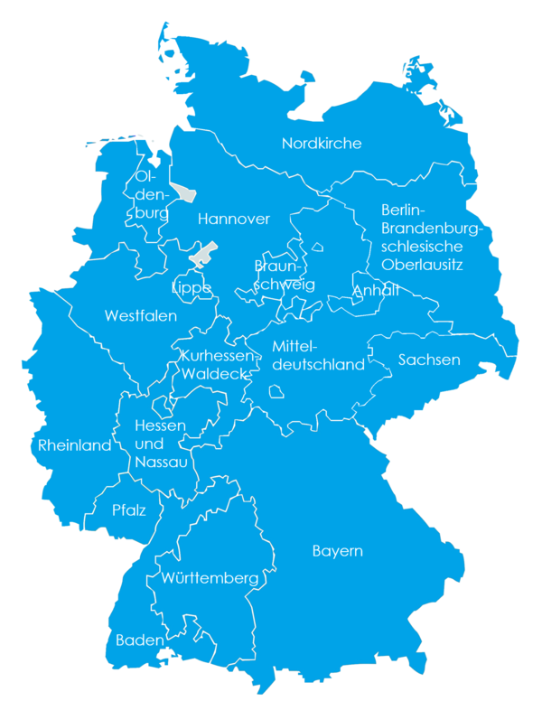
Archion.de
Church registers online
Check map to right
Find Office/Archive
Write or email
Can view online
Revisit frequently

Slide 7
2. Civil Registration
Lookng for Civil Records
As early as 1792 in some areas
1876 Empire-wide
Standesamt is the civil registration office

Slide 8
2. Civil Registration
Some records are digitized online
MeyersGaz.org gives the place for the office, sometimes even the village itself

Slide 9
2. MeyersGaz.org
This is the most important of all German gazetteers.
The goal of the Meyer’s compilers was to list every place name in the German Empire (1871-1918).
It gives the location, i.e. the state and other jurisdictions, where the civil registry office was and parishes if that town had them.

Slide 10
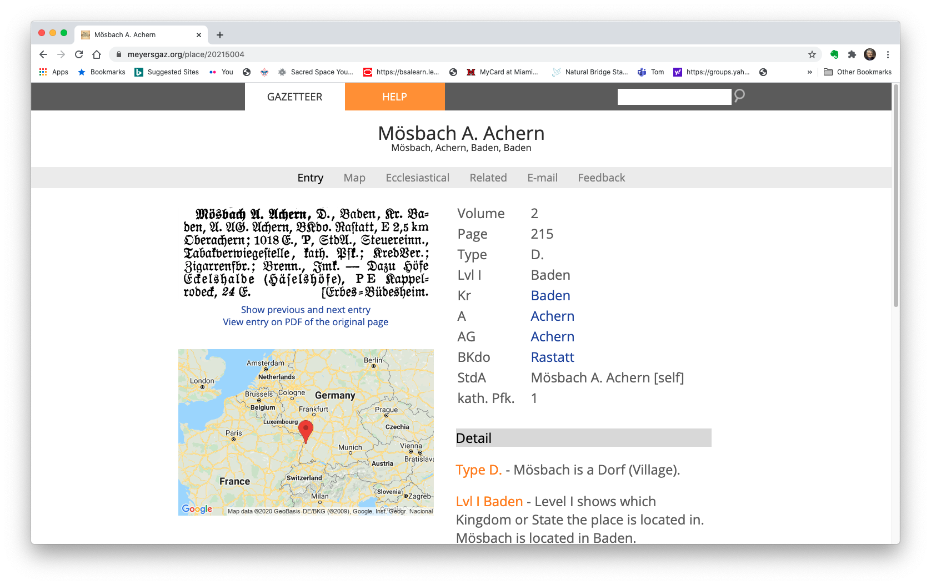
2. MeyersGaz.org
Search: need that Heimat!
Choose the town for which you want more information.
Choose wisely!
Entry, Map, Ecclesiastical
Related. E-mail, Feedback
Regularly check back, review all and Help

Slide 11
3. Village Family Histories
BEST research place is your Heimat
Published compilations of church and civil records
Cross-referencing of many generations

Slide 12
3. Village Family Histories
Dates: vary by town
Also known as Ortsfamilienbücher or Dorfbücher or Familienbüch
Visit Compgen.de has hundreds searchable online

Slide 13
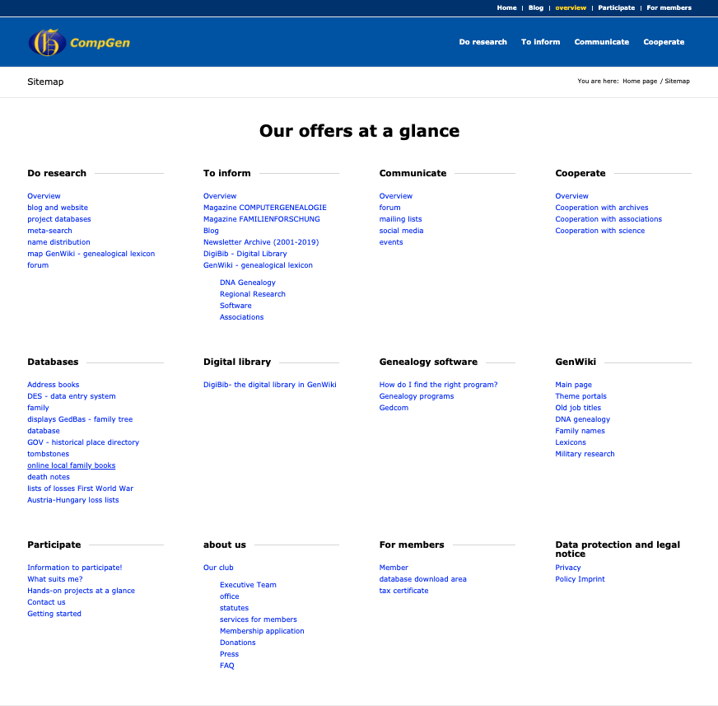
3. Compgen.de
Links to many sub-research sites
Focus on unique Familienbüch
Visit Compgen.de has many topics searchable online

Slide 14
Research
Happy Hunting!

