Slide 1
Photographic Forensics
Two Parts: Forensics and Workshop
Thomas Montgomery and David F. Lahrmann

Slide 2
Photographic Forensics
Identifying People and Dates
Part 1 David F. Lahrmann

Slide 3
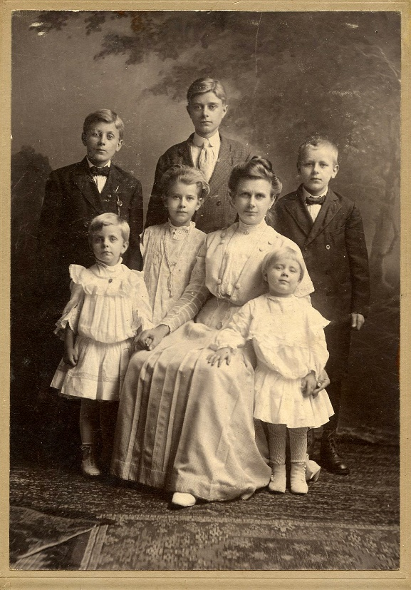
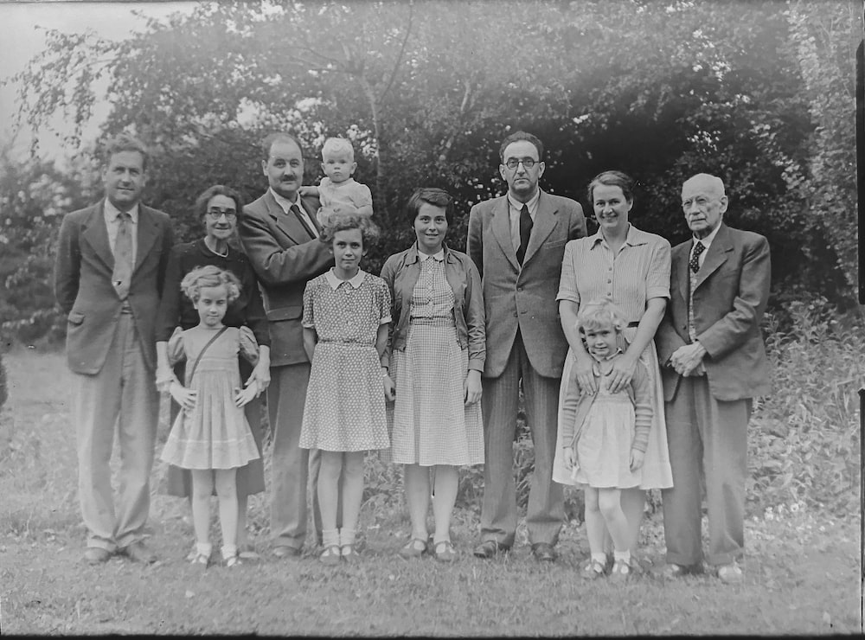
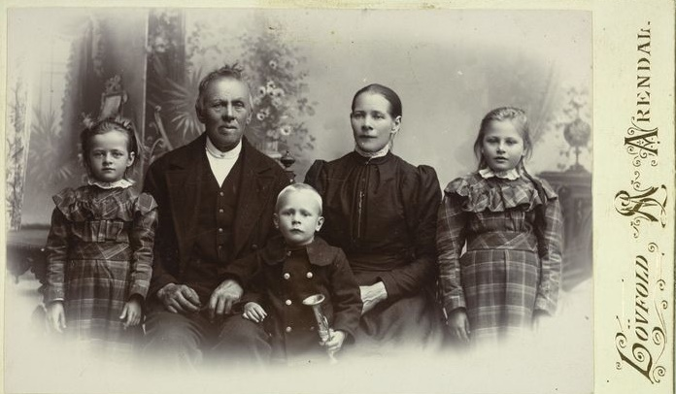
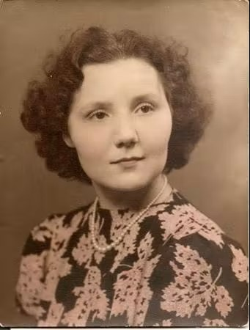
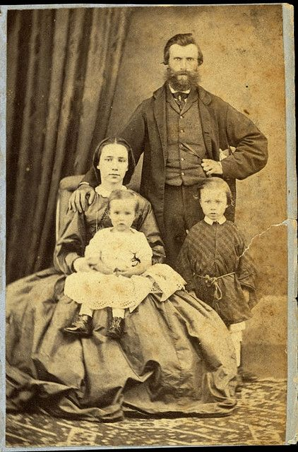
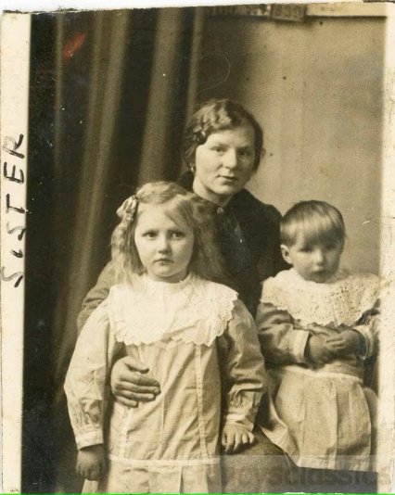
Old Family Photographs
They were taken long before your time
You may know a few people… or maybe no one… but its family
Nothing is written on the photo.. No date… No names
Maybe all are dead now and you know of no one that knows them
There is no way to identify the people in them
What do I do with them?

Slide 4
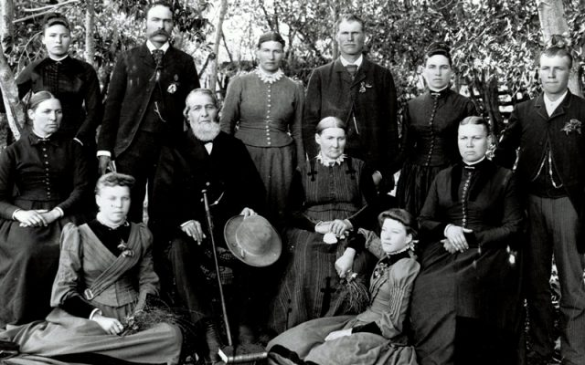
Photographic Forensics
What is it?
  Is the process of identifying people in your photographs and being able to date the photograph and the location where it was taken
  It is a journey that can and will take time but will reward you immensely for your efforts
How does it work?
  Organization
    Retrieve digital photographs when needed for review
  Research
    Collect family facts
  Determination
    Never give up there are clues to every photo

Slide 5
Objective – Identify Who, What, When, Where
People
  Who is in the photograph
Occasion
  What was the event associated with the photograph
Dates
  When was the photograph taken
Location
  Where was the photograph taken

Slide 6
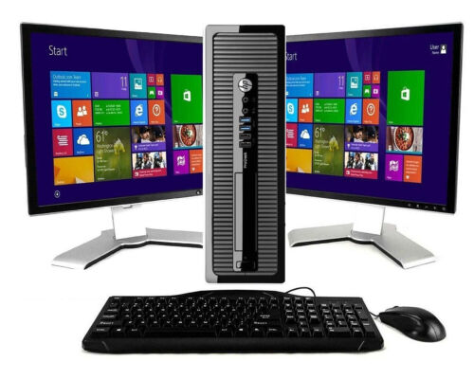
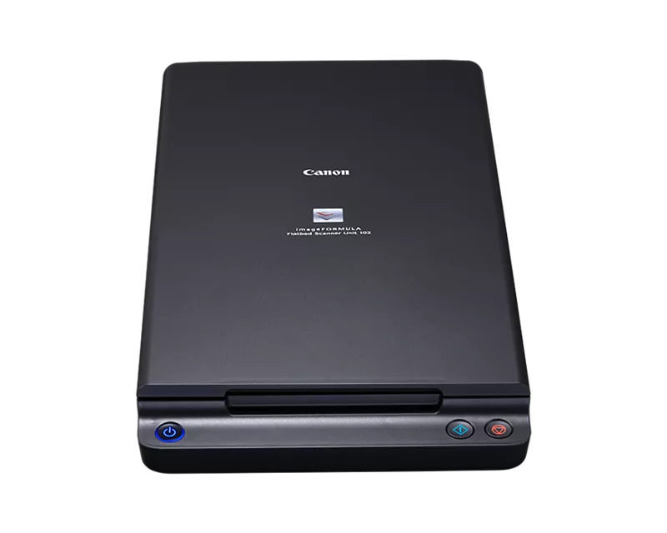
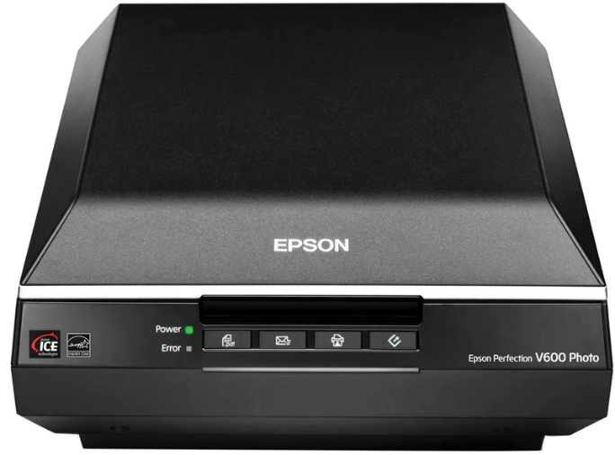
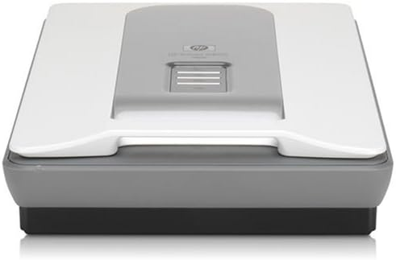
Tools – Computer and Scanner
Computer
  Supports scanner and stores images
Scanners
  Flatbed scanner for digitizing photographs
  Invest in a good one… there are several to pick from
  Will depend upon how much you want to spend
    Epson
    Canon
    HP

Slide 7



Collection & Organization
Collect Family Photographs
  Collect as many photos as you can
  Organize the photographs into potential family groups
Collect Family Facts
  Birth and death certificates, marriage license, etc.
    They contain facts important to a photograph
  Not all facts will be available at one time
Remember it will be a journey
  Each new fact adds to the puzzle
  There may be a new fact that disrupts the story
  Be receptive to information and alternate solutions

Slide 8
Digitization - Scanner
Learn to use the scanner
  Master the software settings
  Scan a single photo
    Experiment using different settings
  Compare the digital images to determine which looks best
  Want to control the outcome of the digitized image
Digitize photographs
  Scan front and back of each photograph
  Scan them as a JPG (or as a TIFF if planning to edit the digital image)
  Scan with at least 300dpi
    The higher the better but generally do not need to go over 1000dpi
  Assign a unique file name
    It is important to create a file naming convention
    Want to be able to quickly locate digital images

Slide 9
Digitization – Websites to Visit
https://familytreemagazine.com/preservation/top-10-genealogy-scanning-tips/
https://www.sassyjanegenealogy.com/scanners-for-genealogy-research/
http://www.genealogyintime.com/articles/how-to-scan-old-photos-for-genealogy-research-page1.html
https://thefamilycurator.com/genealogy-scan-along-week-2-scan-your-photos/
https://www.youtube.com/watch?v=AyyenM7OcjU
https://www.youtube.com/watch?v=9eKBkE3RWsU
https://www.youtube.com/watch?v=3yLUvYoMUYI
https://www.youtube.com/watch?v=42gbBxBudxM

Slide 10
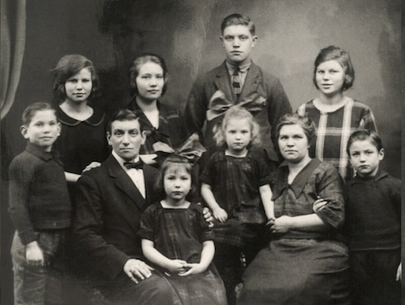
Digital File Organization & Documentation
Important to assign clear file names
  Necessary to be able to locate them on your computer
  Year, Name, Event
  1936, Smith-Jones Family, Christmas.jpg
Place photograph into a MS Word document
  Document information about the photo as it is collected
  Names, dates, locations, etc.
    Use the same file name as the photograph file name
    Store MS word document in the same folder as the photograph
  For example:
    1936, Smith-Jones Family, Christmas.jpg for the image
    1936, Smith-Jones Family, Christmas.docx for the MS Word document

Slide 11
Photograph Documentation
Thomas Smith
Note: This is a photo of the Smith Jones family taken about 1936. Missing the names of the children except for the oldest boy. Need to find photos with the other children to name them
Edward Smith
Samantha Jones
The objective is to document what you know and can easily modified in the future

Slide 12

Photographic Analysis
Computer Image Viewer
  Microsoft “Photos” – its free, can view several photographs at one time
    Different file extensions jpg, bmp, tiff
  Don’t worry about editing the images
Pay attention to the details in the photograph
  Very important to study the image/s
  There are many, many, clues and they will be needed
  Will not fined or see them all at one time
Use computer screen to enlarge and review digital images
  Looking for specific details
  Look for differences and commonality in the details

Slide 13
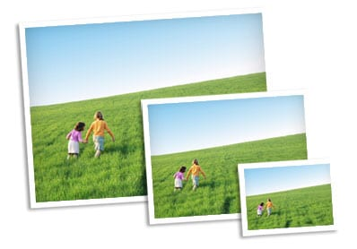
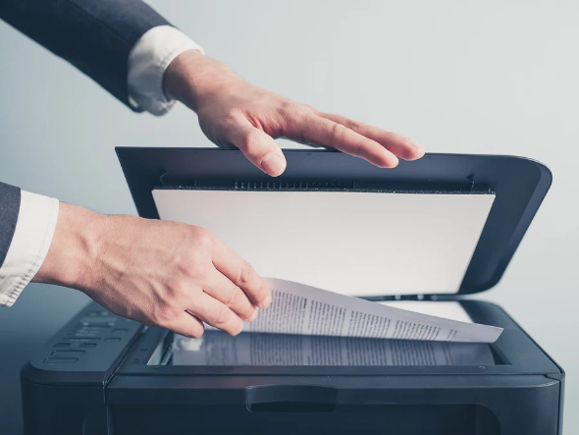
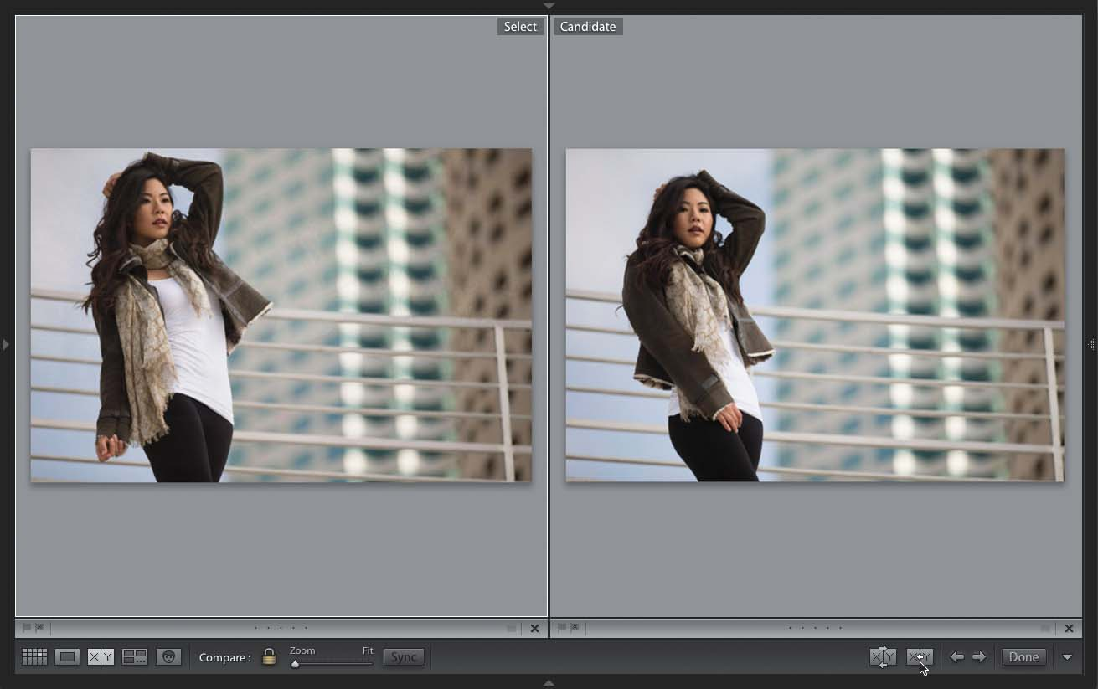
Why it is Important to Digitize the Photo?
Enlarge Digital Images
  Ability to observe the details in the photograph
  Concentrate on specific features
Compare Details
  Between two or more photographs at one time
  Examine a particular feature in the photographs
  Make connections
  Determine information needed to complete the story

Slide 14
Details in the Images
People Details
  Shape, Position, Distance
Faces
  Eyes, nose, lips, ears hairline, eyebrows, chin, cheeks
Body
  Hands, fingers, height, body shape, neck, rings
Clothing
Background Details
  And foreground details
Objects
  Buildings, structures, monuments
Location
  Google Maps has photographs
Objective: Identify Who, What, When, Where

Slide 15
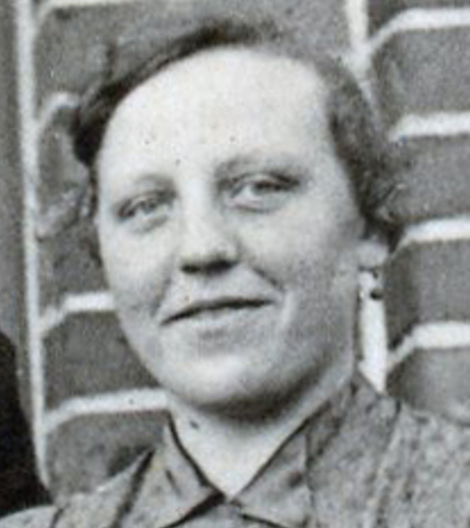
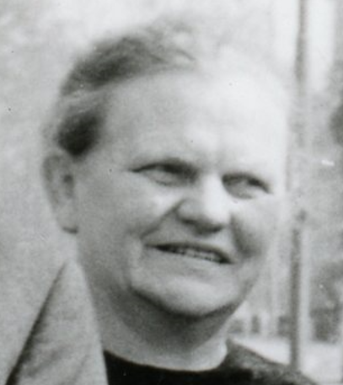
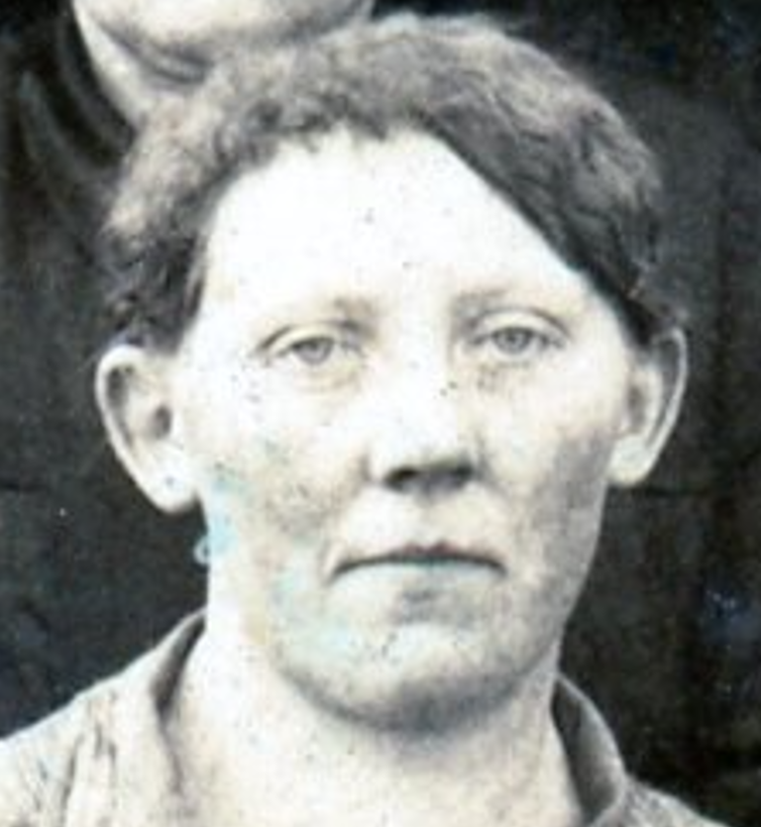
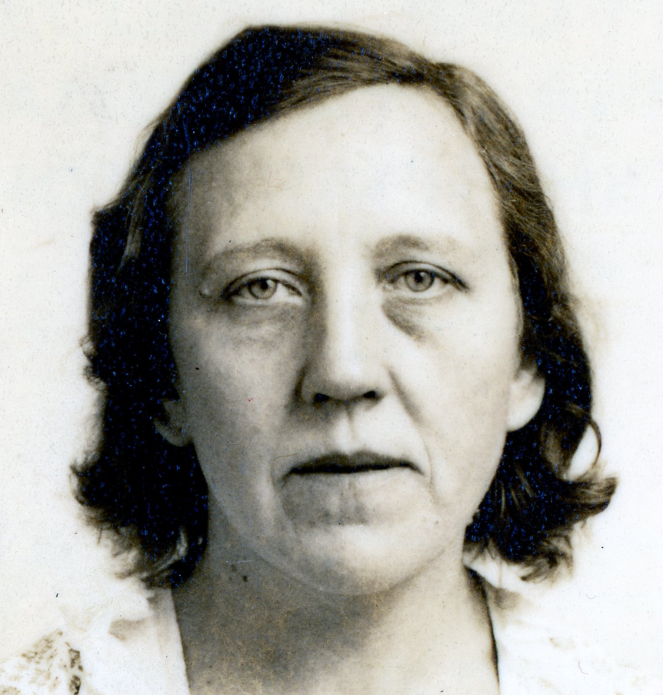
Details - People
Are these images of the same woman?
Look for details to differentiate!

Slide 16
People Facts
Birth certificates
Baptism documents
Marriage records
Divorce records
Death certificates
Burial records
Naturalization records
Property records
Passenger lists
Wills
These documents will be used to help identify people and date a photograph
Objective: Identify Who, What, When, Where

Slide 17
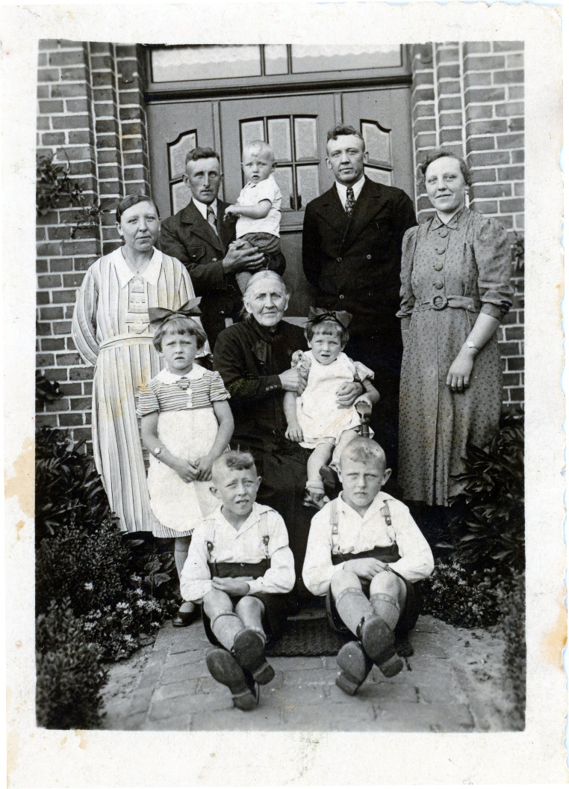
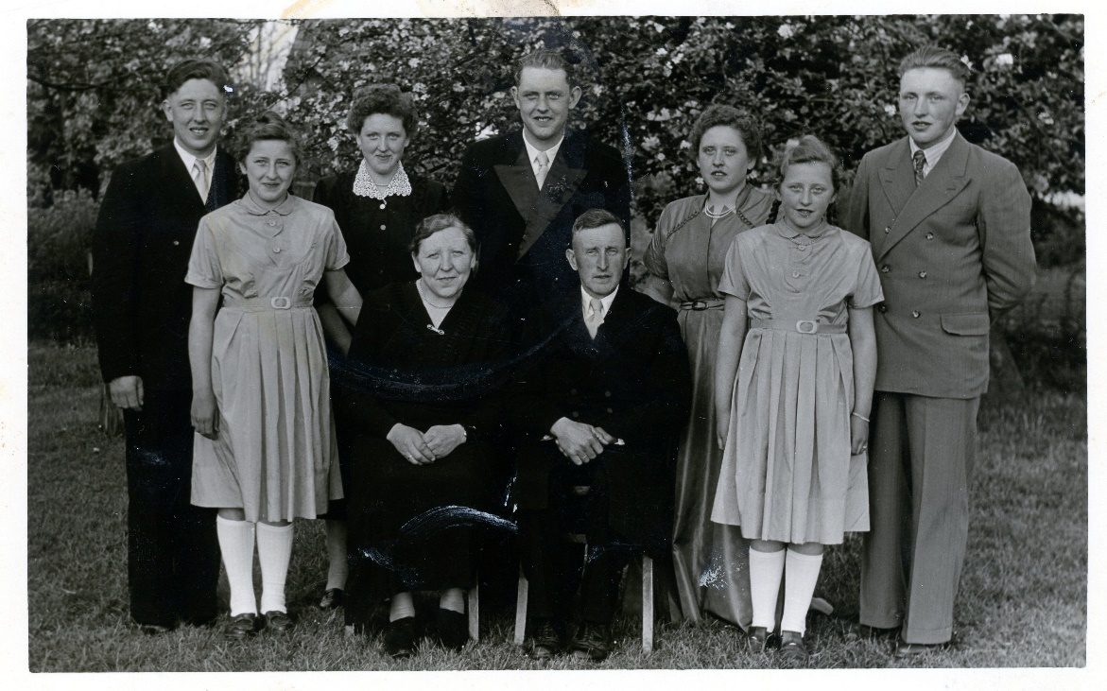
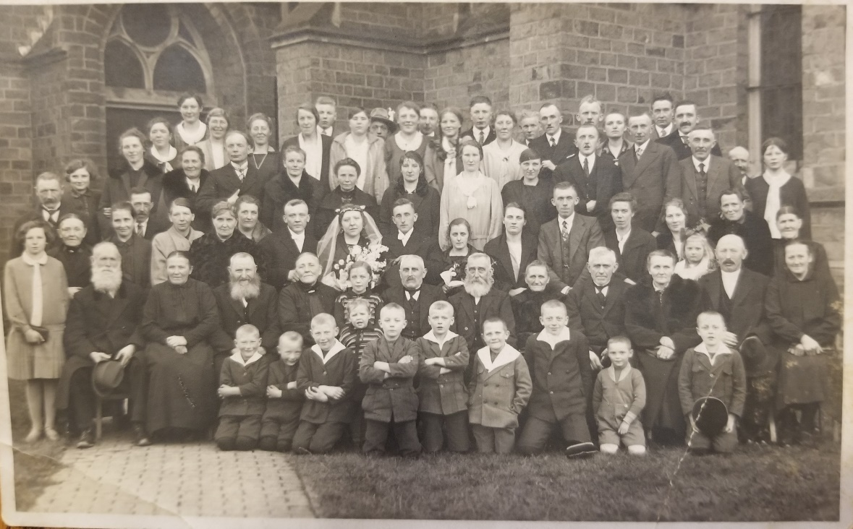
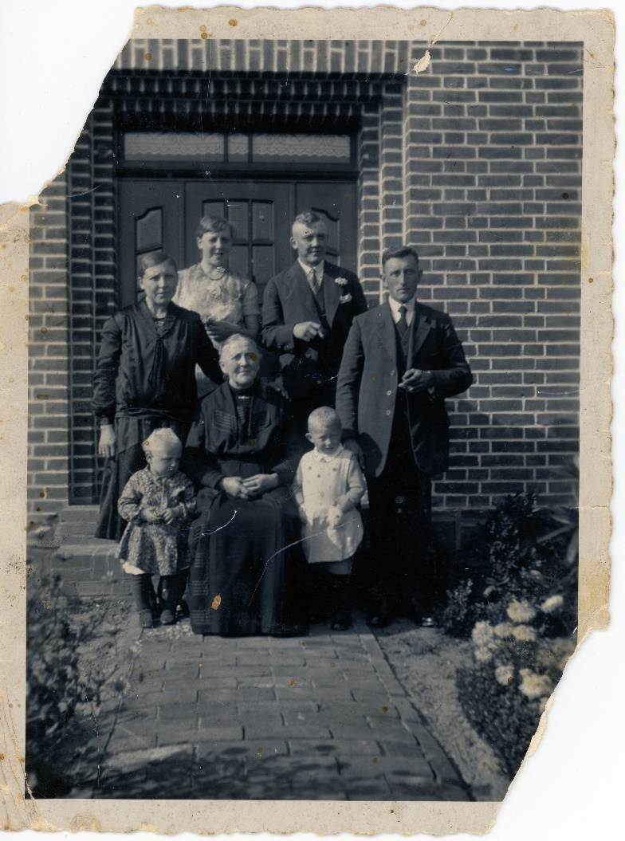
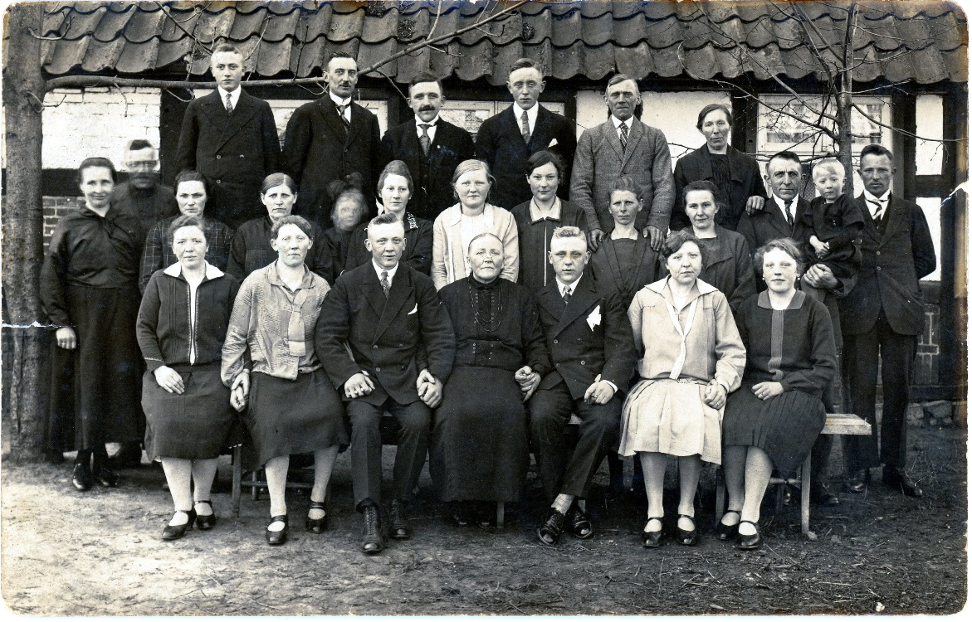
Family Photos - Examples
First Step,
Take a guess at Who, When and Where
These photographs are all related. One person is in all of them

Slide 18

Initial guesses
  Couple married abt 1924
  Who
    Woman on far-right Elisabeth Pohlmann
    Woman sitting is Maria Pohlmann
    Children?
    Man standing on right maybe August Grote?
  What
    Birthday, Easter?
  When
    Abt 1932
  Where
    ?, Germany
Estimate Photo Date
  Late Summer of 1930 maybe 1932
Passenger list for Elisabeth Pohlmann says she returned in Sept 1932
  Lady on far right
  Lived in United States

Slide 19
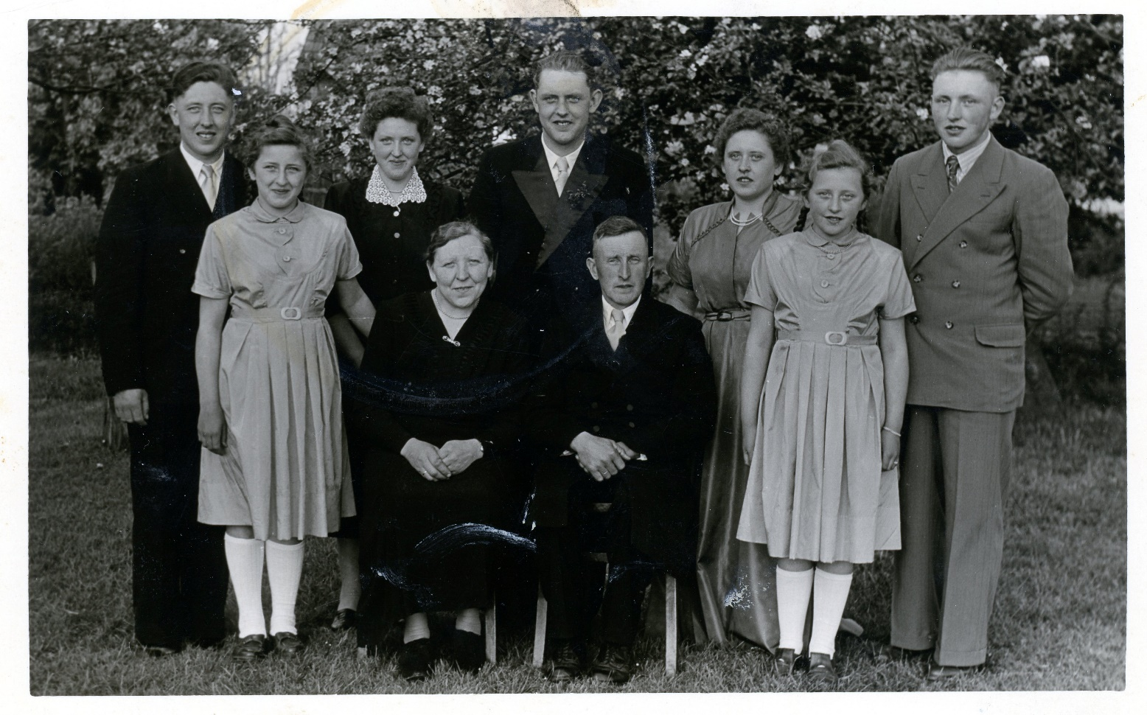
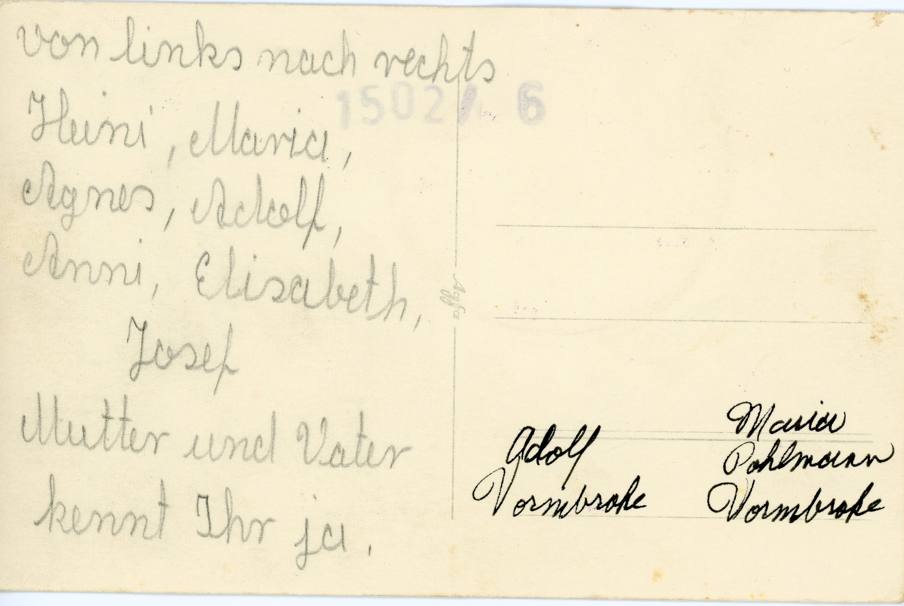
Scan Front and Back of Photos
Family Photograph with names on the back

Slide 20
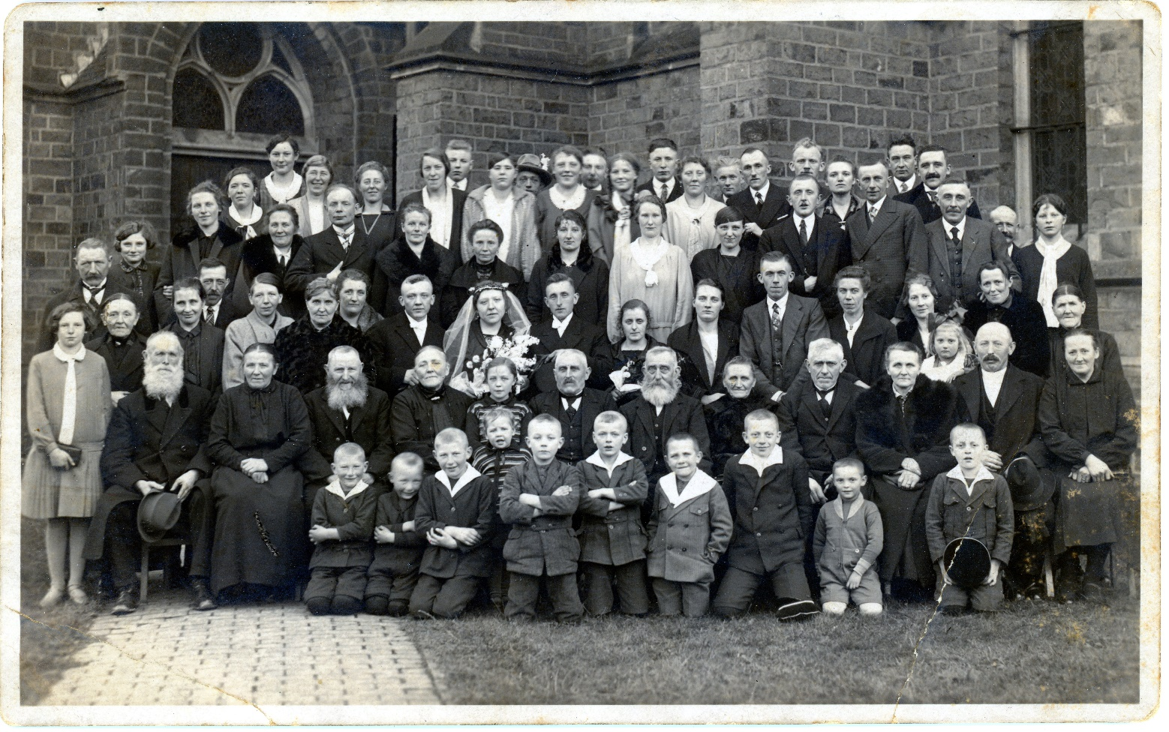
Details – Background & Foreground
Wedding Photo
  Estimated the date was 1924
  Location in Germany
Look for details
  Beyond the people
What is in the foreground?
What is in the background?
Want to identify the location the photographs were taken
1920s Family Photograph
Look for details to Identify Locations

Slide 21
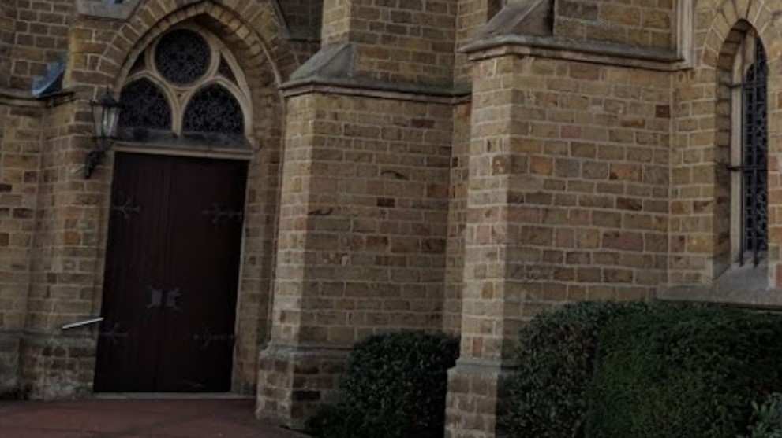
Details – Background & Foreground
1920s Family Photograph
Recent Photograph from Google Maps
St. Laurentius Church in
Neuenkirchen (Hülsen), Germany
Look for details to Identify Locations

Slide 22
Family Photograph Taken
  After 30 Sept 1937
    Birth of Youngest person in the photo
    Klemens appears to be abt 12 months old
  Before 27 Nov 1939
    Maria Anna Pohlmann dies
  Marriage 19 Nov 1929
    Adolf Vorm Brocke and Maria Katharina Pohlmann
Estimate Photo Date
  Summer of 1938
The journey to identify family members, date, and location took ~6 years
Heinrich Aldof Vorm-Brocke
Klemens Josef Vorm-Brocke
Gerhard Heinrich Pohlmann
Maria Bernardine Lohmann
Maria Vorm-Brocke geb Pohlmann geb 1904
Bernadine Maria Anna “Anni” Vorm-Brocke
Agnes Gertrude Vorm-Brocke
Adolf Heinrich “Heini” Vorm-Brocke
Gerhard Aldof Vorm-Brocke
Maria Anna Pohlmann geb auf der Heide

Slide 23
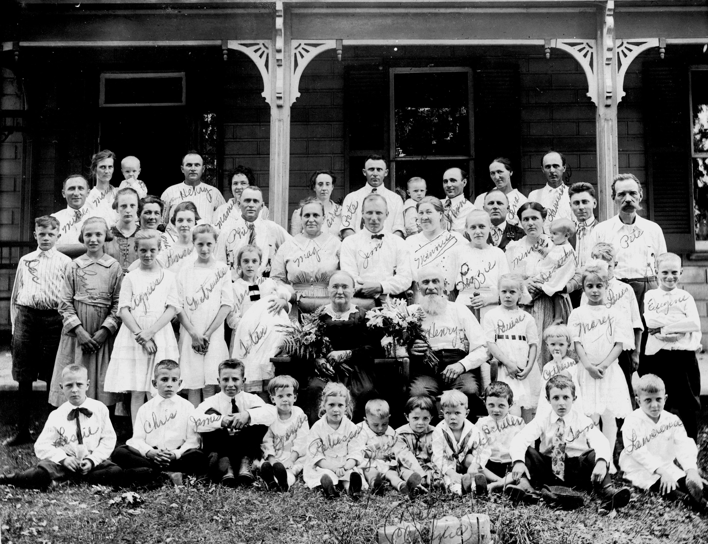
Use Internet Resources
Photos contained in Family Trees
  Ancestry.com
  MyHeritage
Look at other Family Trees as they may have photos

Slide 24
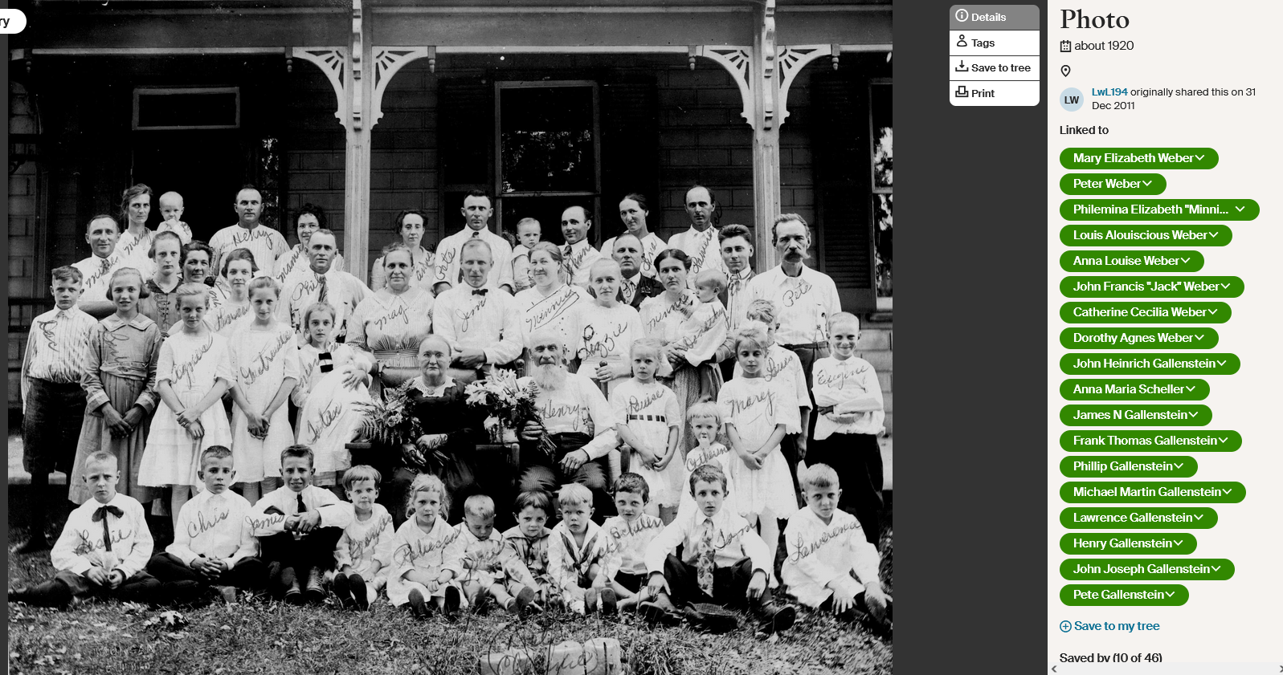
Ancestry.com

Slide 25
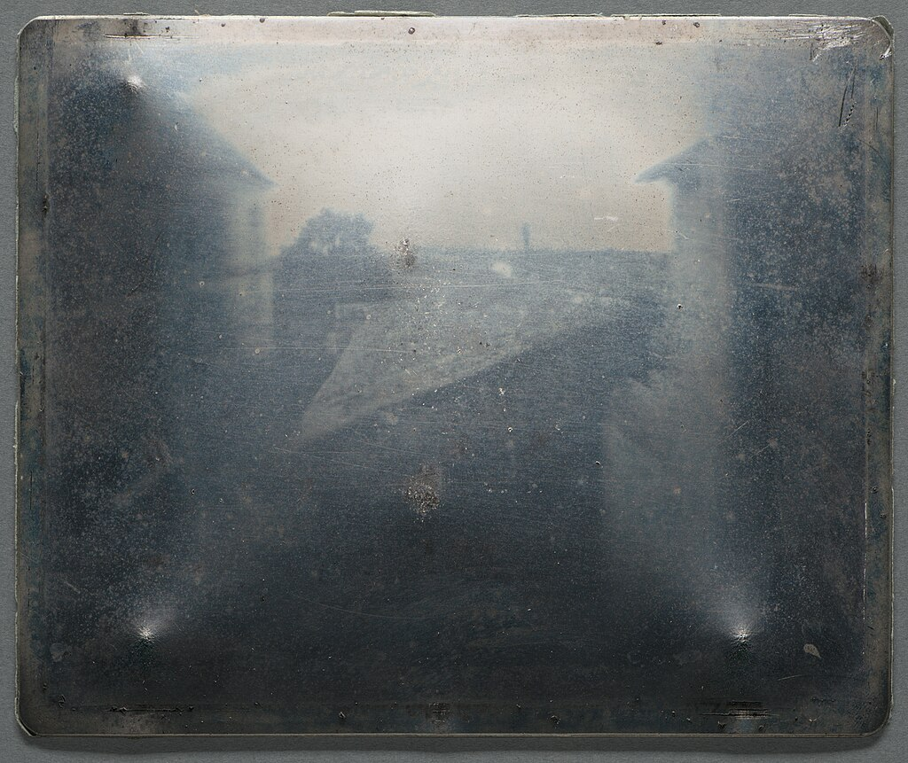
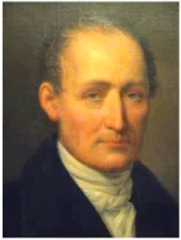
Worlds Oldest Surviving Camera Photograph
Taken by French Inventor Nicéphore Niépce
Taken between 1826 and 1827 “Point de vue du Gras” or “View from the Window at Le Gras”

Slide 26
Resources
Books by Maureen Taylor
  Family Photo Detective
  Preserving Your Family Photographs
  Identifying Family Photographs – The handbook
  Uncovering Your Ancestry through Family Photographs
https://maureentaylor.com/

Slide 27
My Heritage – Image Tools
Photo Enhancer
  Sharpens blurry photos and does a good job of it
  https://familytreewebinars.com/webinar/new-breakthroughs-in-myheritages-photo-tools/
Photo Tager
  Uses AI to identify people in photos or to identify the same individual in different photos
  Works to identify individual as they age
  https://familytreewebinars.com/webinar/the-latest-photo-feature-from-myheritage/
Photo Dater
  Dates a photograph based upon clothing in the photo.
  https://familytreewebinars.com/webinar/the-latest-photo-feature-from-myheritage/

Slide 28
Summary – Photographic Forensics
It is the Process
  Establish possible scenarios
  Asking questions is important
It is a Journey
  Constantly look for clues and photographs
It requires Organization, Research, Determination
Objective – Identify Who, What, When, Where
It will reward you immensely for your efforts
Patience Will Bring Success!

Slide 29
Enjoy the Journey!

Slide 30
Photographic Forensics
Scanner Workshop
Part 2 Thomas Montgomery and David F. Lahrmann

Slide 31
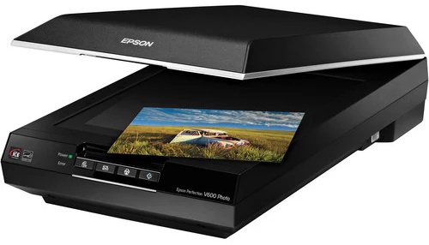
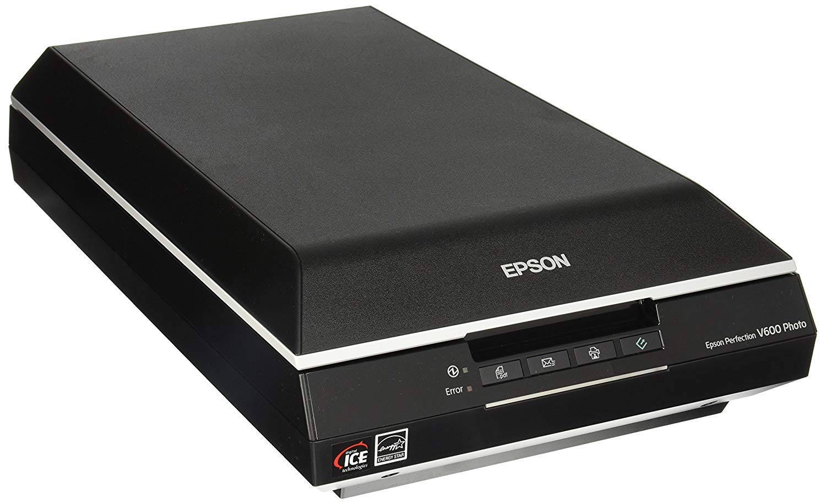
Part 2 – Workshop Objectives
Learn to use a scanner
  Scan a few photographs
  Experience different settings
Epson V600 Scanner

Slide 32
Part 2 – Managing the Scanner
Scanner Controls
  Mode
  Document Type
  Document source
  Auto Exposure
  Image Type
  Resolution
Effect of image resolution
Photo Comparison
DPI and pixels are related but refer to different aspects of image resolution. DPI (Dots Per Inch) measures the density of dots of ink on a printed image, while pixels are the individual color units that make up a digital image

Slide 33
Part 2 – Managing the Scanner – Steps
Place the photograph on the image bed
Turn on the scanner
Start the scanner software on the computer
Preview the image on the scanner
Select the area to be scanned in the Preview Pane
Select the image resolution (DPI) and other adjustments
“Scan” the photo
Assign the File Name
Select Image Format
Press “OK”
asdgf

Slide 34
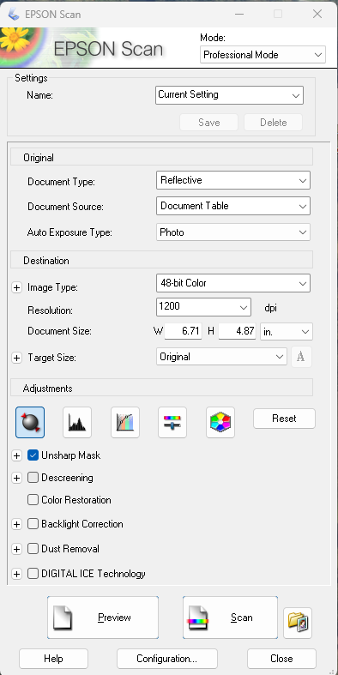
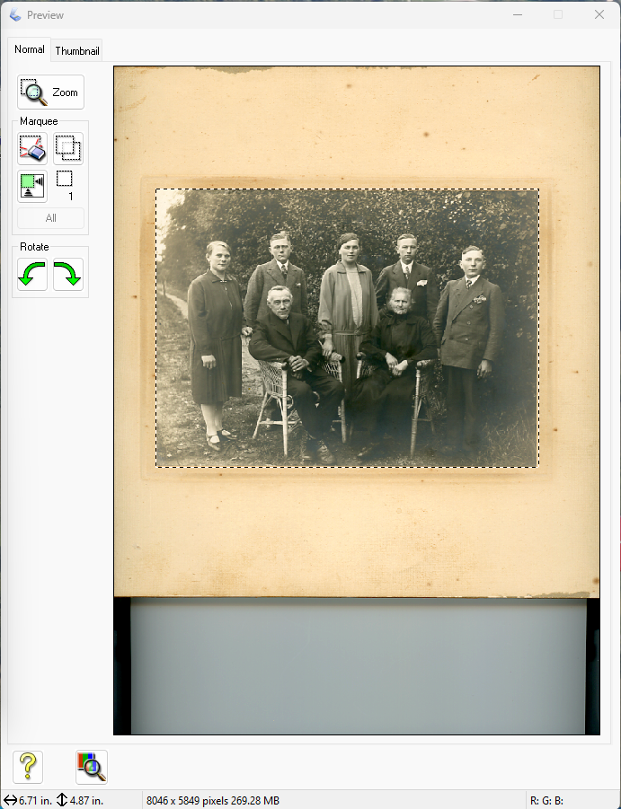
Scanner
Settings
Preview of photo on the image Bed of scanner

Slide 35
Full Auto to Professional Modes
Scanner
Settings
Reflective or Film
Photo or Document
48-bit & 24-bit Color, Color Smoothing, 16-bit & 8-bit Gray sale, B&W
dpi setting 50 dpi to 12800 dpi
Image Size on Image Bed
Understanding how to use the Scanner is important to achieve high quality digital images
Image correction tools

Slide 36
Preview of Image
Preview of photo on the image Bed of scanner

Slide 37
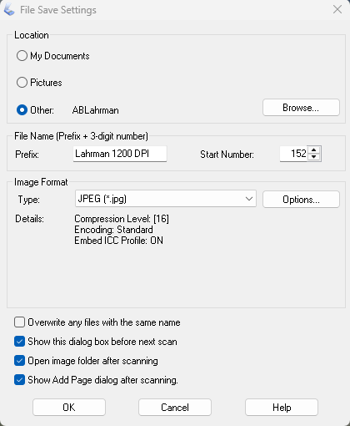
Where the image will be stored
Name assigned to the image
Image format: BITMAP (*bmp), JPEG (*jpg), PDF (*pdf), TIFF etc
Image Size on Image Bed

Slide 38
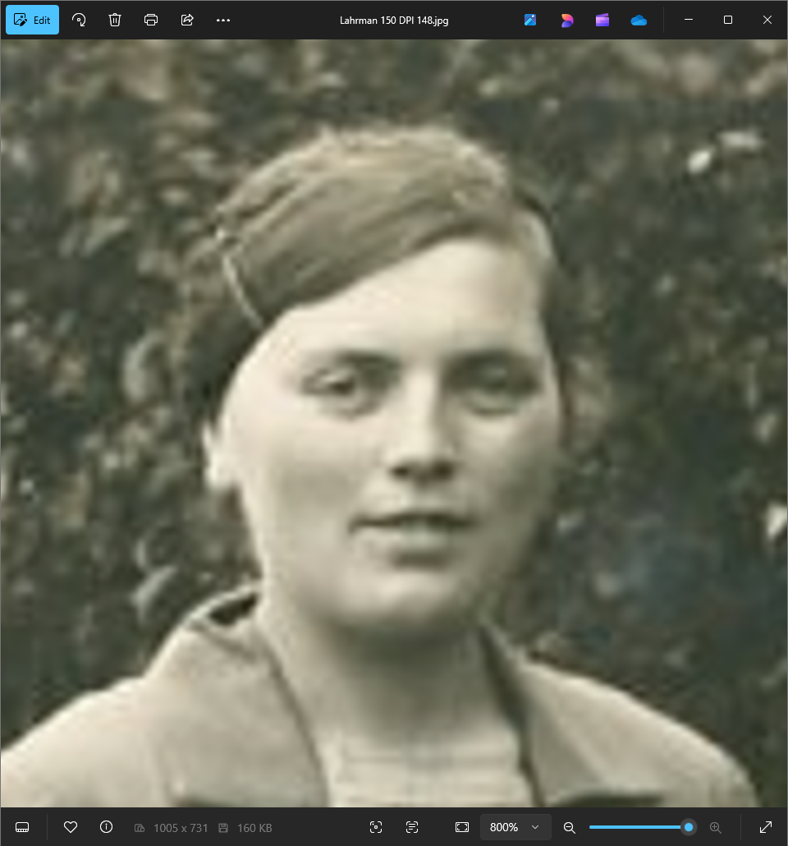
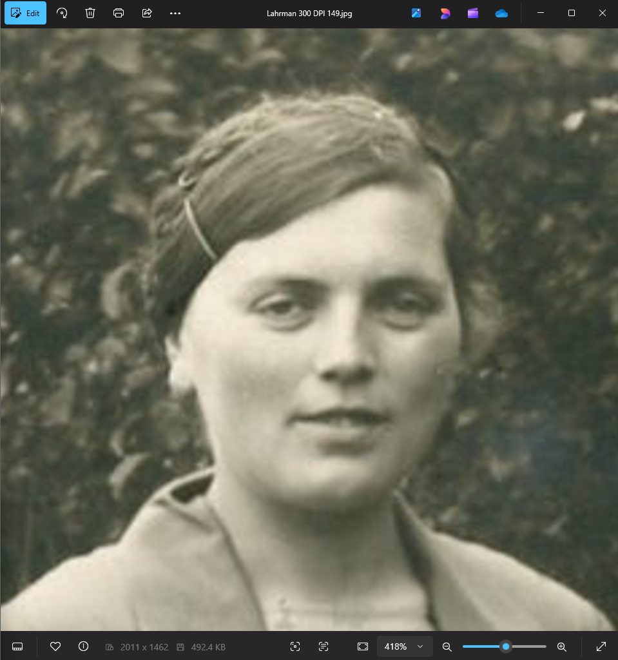
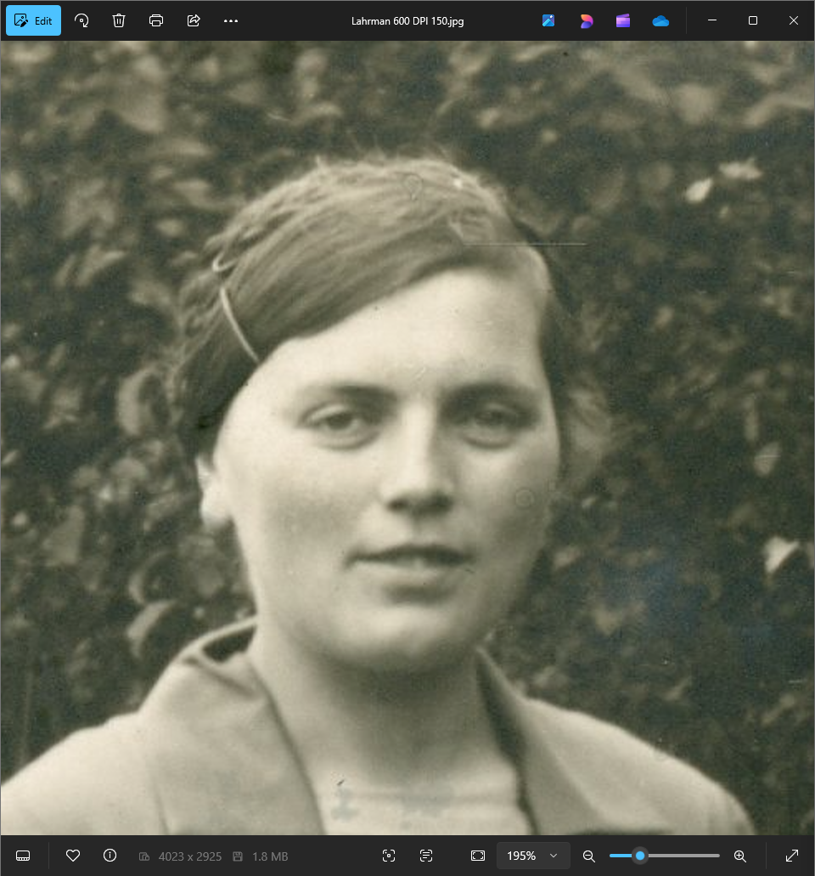
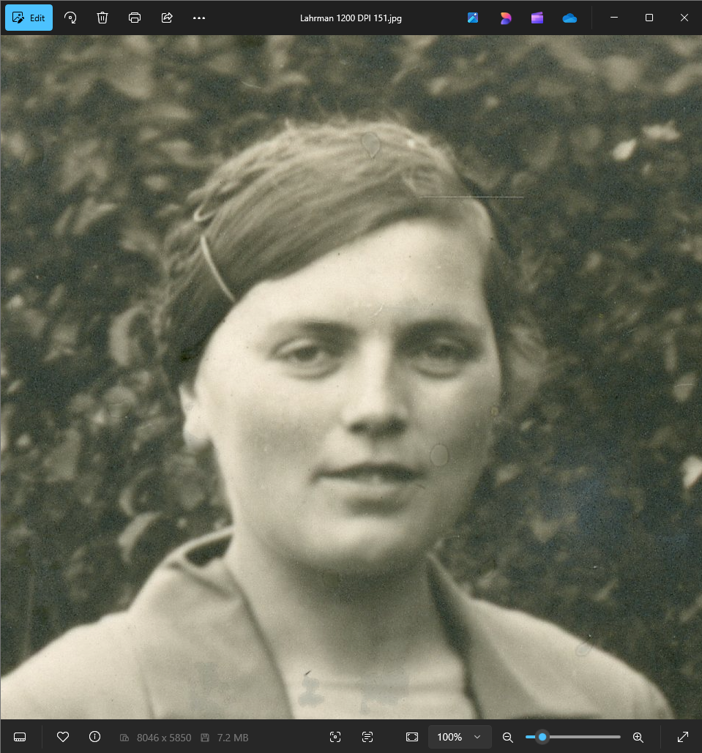
150 DPI
300 DPI
Effect of Increasing the Dots per Inch
600 DPI
1200 DPI
DPI means dots per inch

Slide 39
150 DPI
300 DPI
600 DPI
1200 DPI
DPI means dots per inch

Slide 40
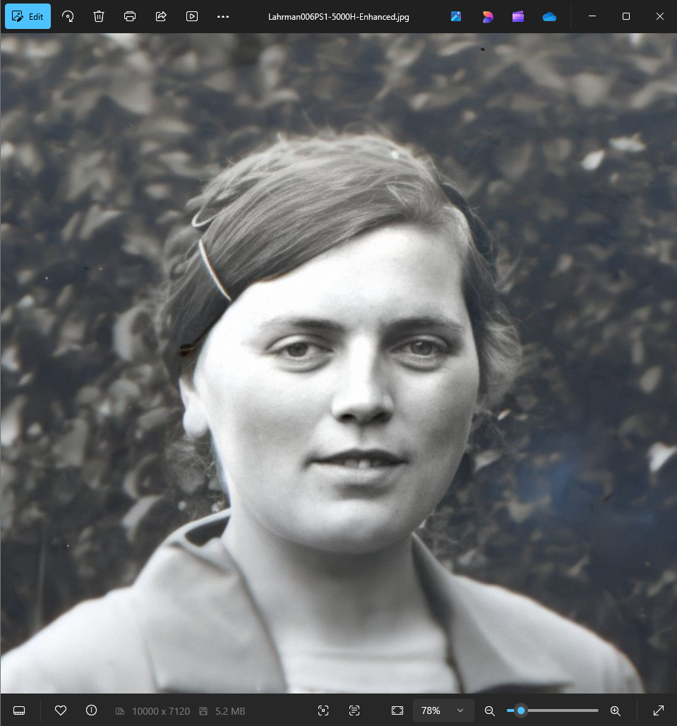
150 DPI
1200 DPI
600 DPI
300 DPI
1200 DPI Scanned Image
Image Enhancement on MyHeitage

Slide 41
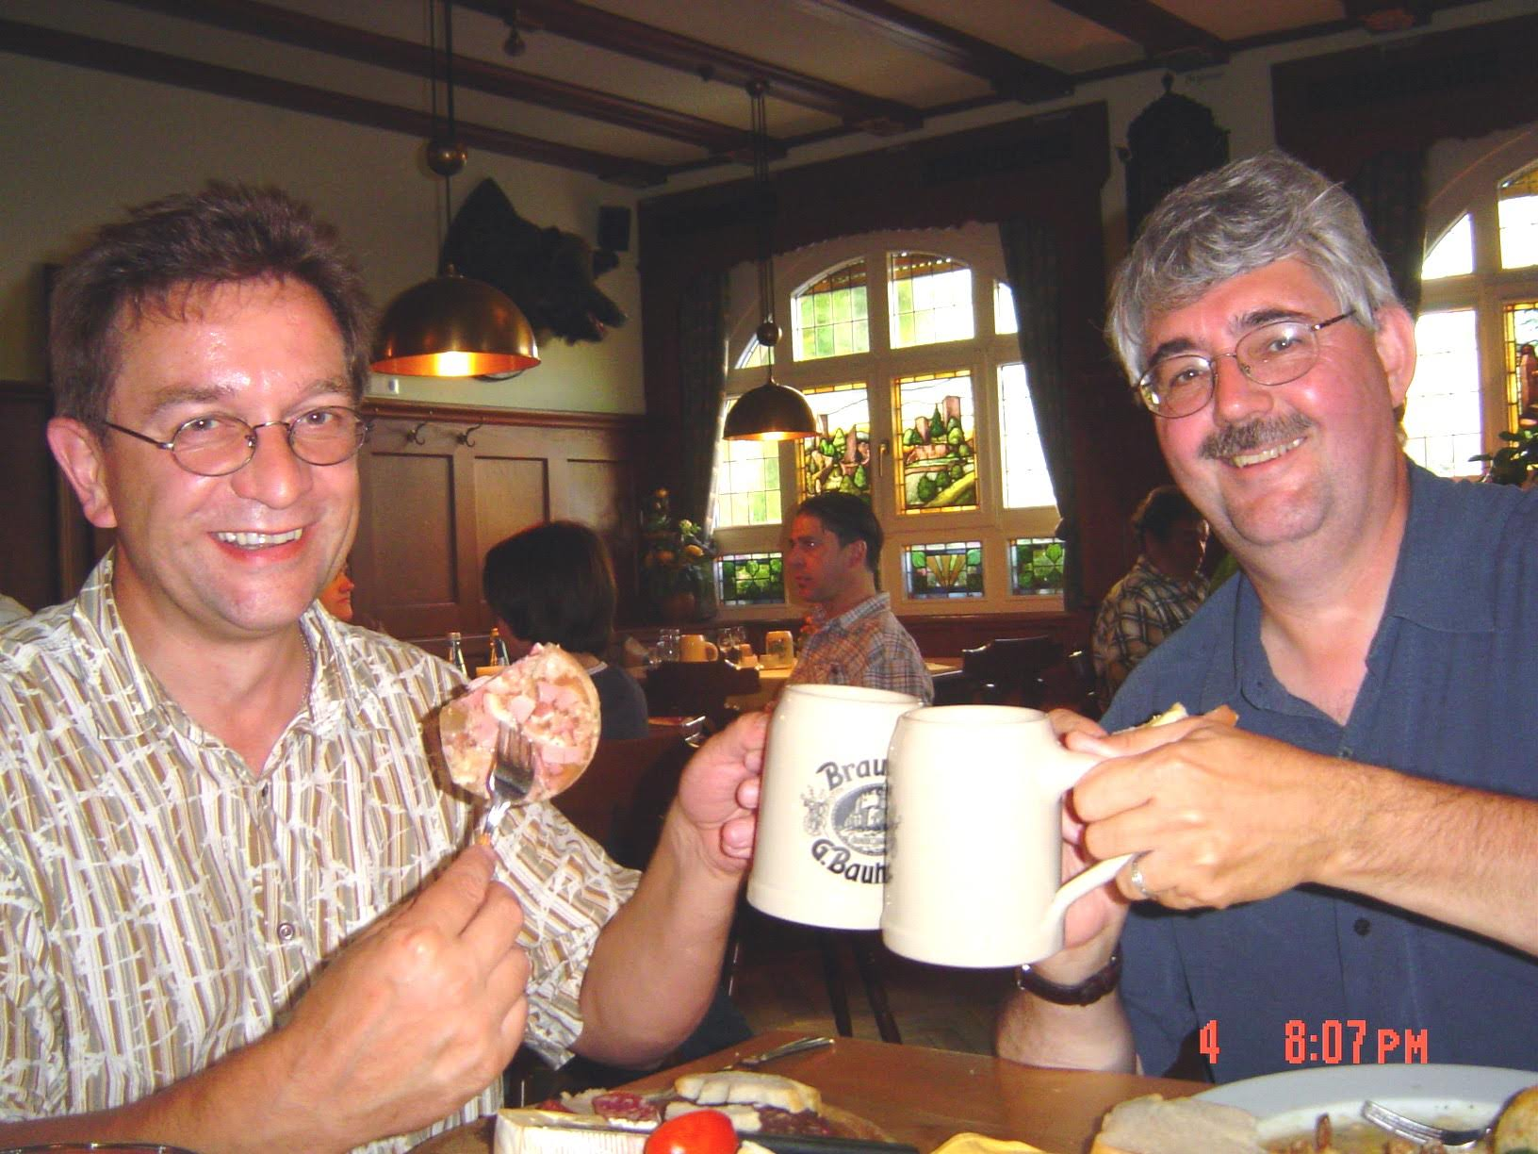
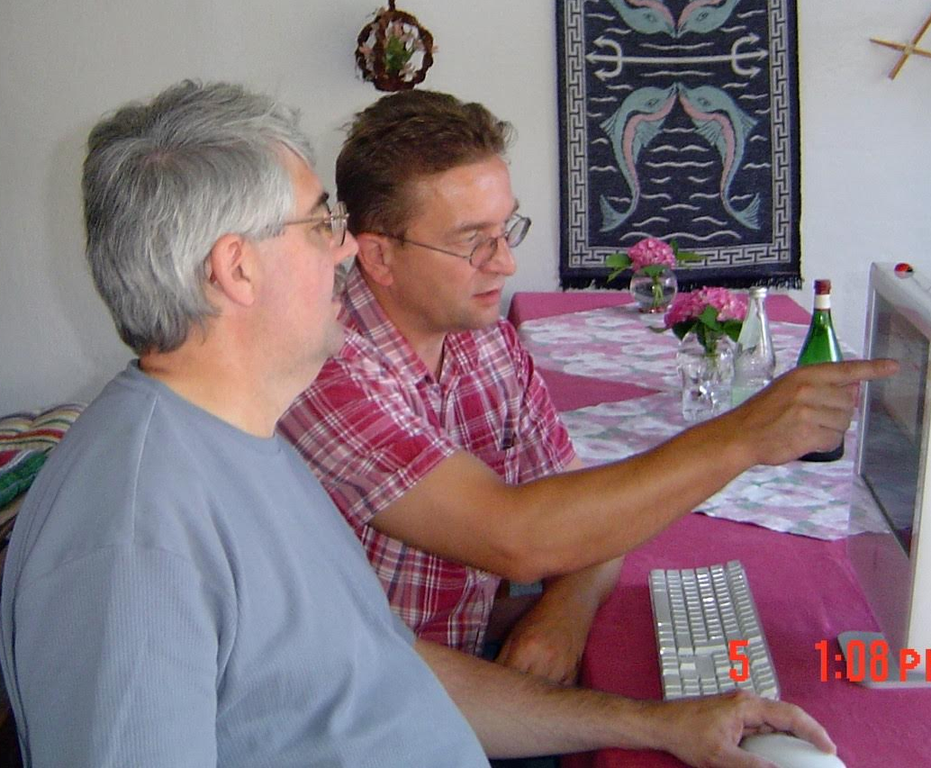
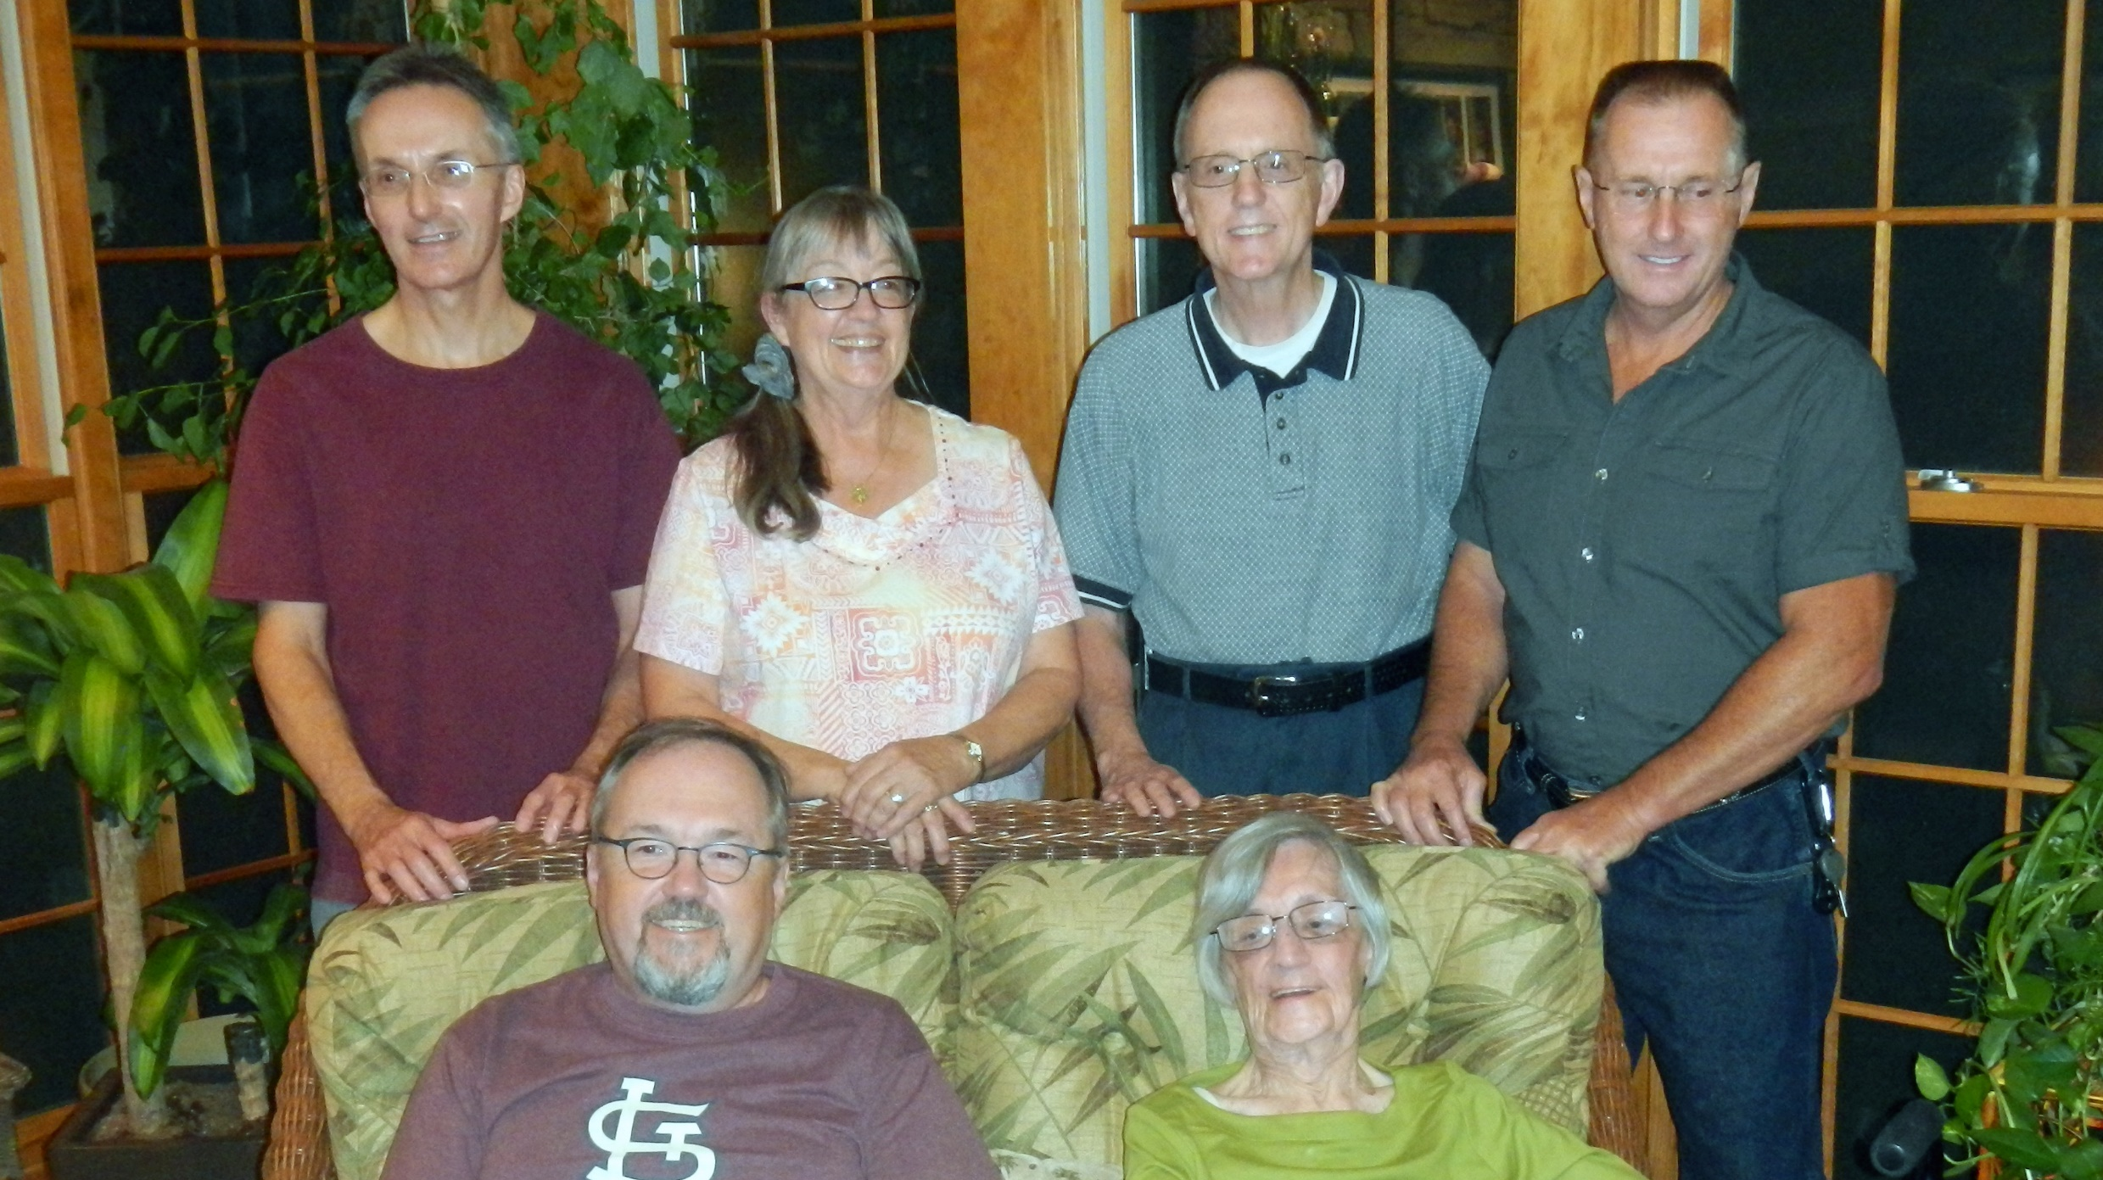

Slide 42
Enjoy the Scanning!

Slide 43
Family Photograph Taken
  After 30 Sept 1937
    Youngest person in the photo
    Appears to be 12 to 18 months old
  Before 27 Nov 1939
    Oldest person die
Estimate Photo Date
  Summer of 1938
Need to find Passenger list for 1939 for Elisabeth Grote
  Lady on far right
  Lived in United States

