Slide 1
Family Tree Maker
Thomas A. Montgomery

Slide 2
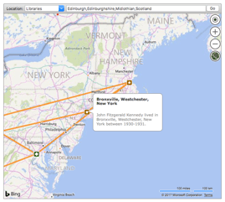


Program Selection
Historical records database
Geographic tools
DNA tests
Community Forums
Focus on heritage
Ability to add Media
Easy to learn
Cross platform and media
Links to web-based search engines

Slide 3

Main Menu
Plan
  Tasks
  Change Log
People
Places
  Maps of all locations
Media
  Facts
  Links
  Notes
Sources
  Citations and Details
Publish
  Charts & Reports
  Publications
Web Search

Slide 4
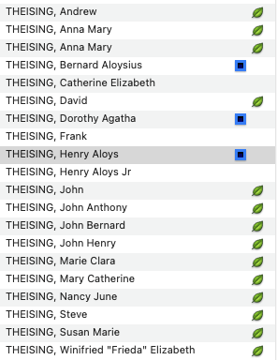

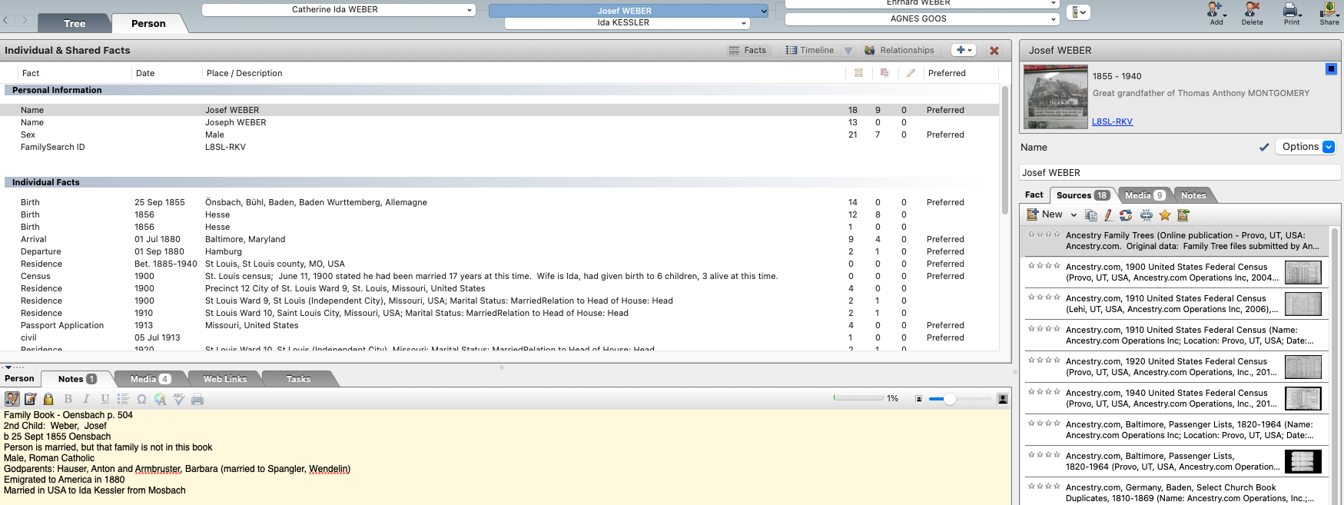

Tree Views
Index Panel – two views
Bookmarks
History

Slide 5
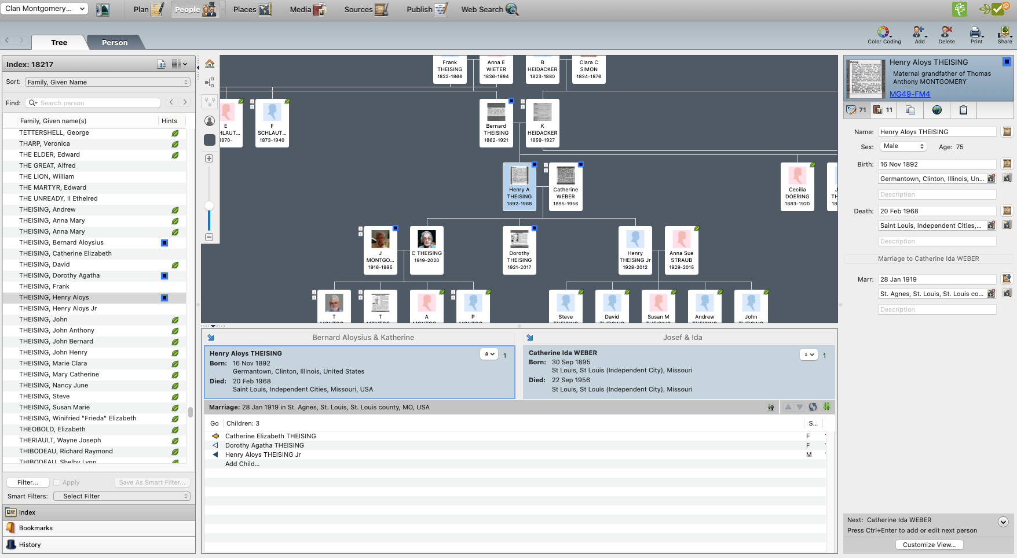
Index Panel
Index Panel-Tree
  Home
  Pedigree View
  Family View
  Re-center on selected person
  Background color
  Zoom
  Spouses and Children

Slide 6
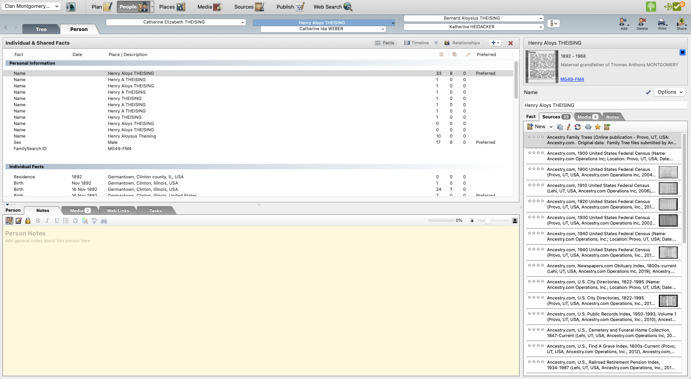
Index Panel
Index Panel-Person
  Individual & Shared Facts
  Person
  Notes
  Media
  Web Links
  Tasks

Slide 7


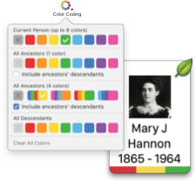



Linkages & Hints
Family Search
Ancestry
  Family Tree Maker
  RootsWeb
  Fold3
  Archives
  Newspapers
Color Coding
Add
Delete
Print
Share

Slide 8

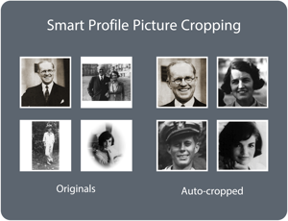



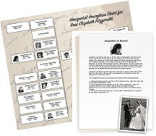
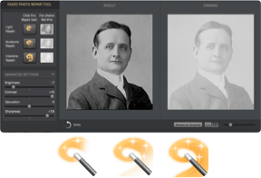

Family Tree Maker
TreeVault
FTM Connect
Historical weather
Next of Kin
Tree Browser
Color Coding
Smart Filters
Profile Picture Cropping Tool
Charts & Reports
Darkroom
Multi-computer
Syncing
Support Ukraine

Slide 9
Happy Hunting!

