Slide 1
Photos and Scanners
Notes:
Slide 1
From Tracing Your Germanic Ancestors
p. 24
Most settled in the middle Atlantic colonies.
Immigrants before 1850 were mostly farmers.
After 1840, many German immigrants came to American cities, where “Germania’” or German-speaking districts, soon developed.
p. 25
Immigrants often travelled with friends.
Early Colonial German Passenger lists are available (Philadelphia)

Slide 2
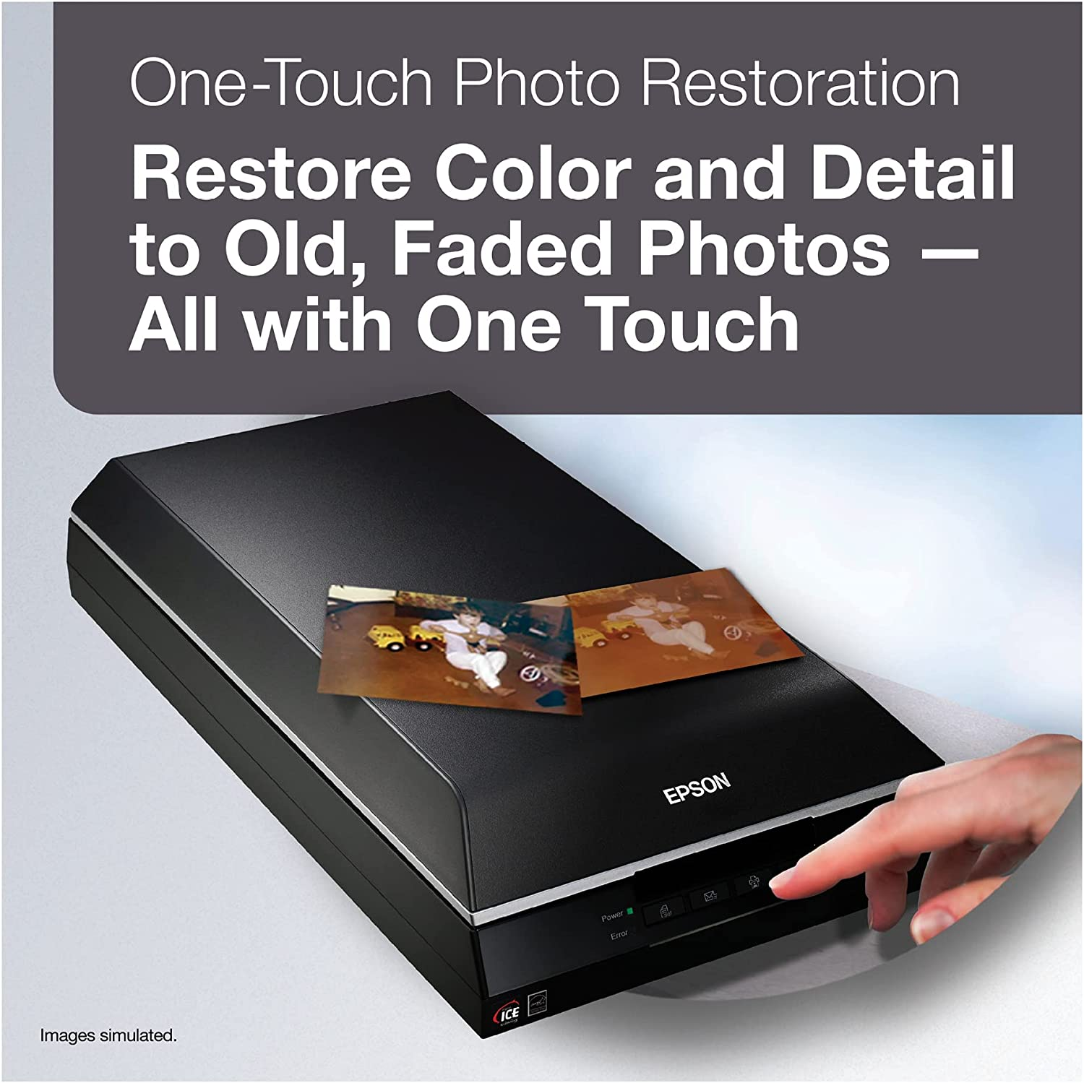
Input –Using a Scanner
Good quality flatbed scanner
Comes with own software
Accomodates different formats (4X6, 35 slides, negatives)
Is NOT portable
https://www.pcmag.com/picks/the-best-photo-scanners
https://www.archfoundation.org/best-photo-scanners/
Can interface with Adobe PhotoShop or Lightroom
Vuescan is easy to use
Be prepared to spend hours input your photos

Slide 3
DPI & Resolution
When you scan photos, choose a scanner resolution based on what you plan to do with the photo and whether you plan to enlarge it. The scanner resolution you choose for your photos impacts not only how the digital image looks, but also what you can do with that image.
Generally scan your 4X6 photo at 300 dpi
If enlarging this same photo for a larger frame or gift print, scan at 600 dpi
If Archiving all your work, scan at 1200 dpi
Professional photographers will often save their best images in both jpeg and tiff formats.
Scanning at higher resolutions takes more time and more storage space.
https://stuffoholics.com/best-dpi-for-scanning-photos/
https://memorywise.com/photo-scanning-resolution/
https://www.scancafe.com/blog/best-resolution-to-scan-old-photos/
https://kodakdigitizing.com/blogs/news/what-is-the-best-resolution-to-scan-old-pictures
https://photoprolist.com/what-you-must-know-about-photo-scan-resolutions-and-dpi-for-scanning-photos/
https://www.photodoto.com/a-quick-primer-on-resolution-and-photo-scanning/
https://www.photoreview.com.au/tips/outputting/how-to-scan-photos-at-the-right-resolution/

Slide 4
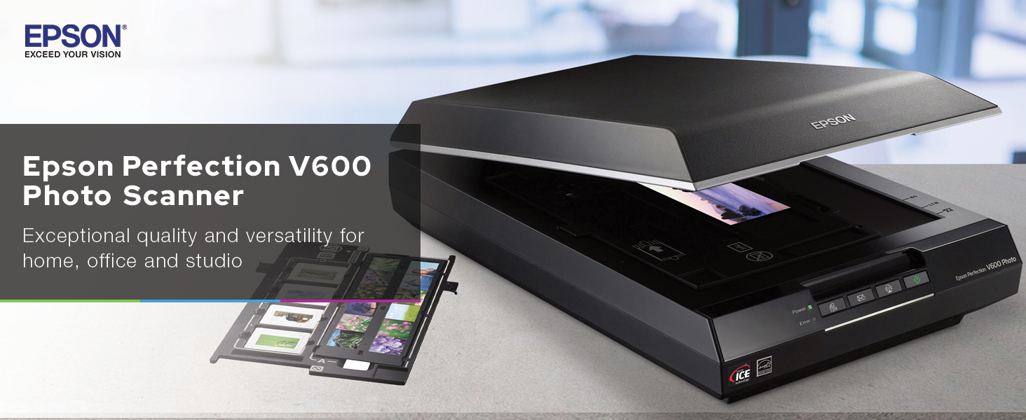
35 mm Slide and Negatives
http://www.whiteglovescanning.com/page/5732190

Slide 5
Editing your Scans
PhotoShop is expensive as is Lightroom
There are affordable alternatives
Adobe Express
https://www.adobe.com/products/photoshop-express.html
Gimp, Paint
https://www.lifewire.com/best-free-adobe-photoshop-alternatives-4140697
Windows 10 Photos
https://skylum.com/blog/best-free-photoshop-alternatives
PhotoWorks
https://wp-modula.com/free-photoshop-alternatives/
See hints in Photo Rx
Digitizing Your Family Treasures

Slide 6
Managing and Organizing Your Digital Collections
Download all scans into ONE place on your computer
Edit and organize your photos on your computer
Use a standard naming system
Identify or “tag” your pictures
Create backups in the cloud
Keep your storage up-to-date
Ensure future access to your digital photo collection

Slide 7
Research
Happy Scanning!
Notes:
Slide 15.

